Slide 1
Introductions to Cloud Computing (AWS)

Slide 2
What is cloud computing?
Cloud computing is the on-demand delivery of IT resources over the Internet with pay-as-you-go pricing. Instead of buying, owning, and maintaining physical data centers and servers, you can access technology services, such as computing power, storage, and databases, on an as-needed basis

Slide 3
Who is using cloud computing?
Organizations of every type, size, and industry are using the cloud for a wide variety of use cases, such as data backup, disaster recovery, email, virtual desktops, software development and testing, big data analytics, and customer-facing web applications.

Slide 4
Benefits of cloud computing
Elasticity
Cost savings
Deploy globally in minutes
Security
Cloud computing offers 24/7 uptime (99.99% uptime).

Slide 5
Types of cloud computing
Infrastructure as a Service (IaaS) : Contains the basic building blocks for cloud IT. It typically provides access to networking features, computers and data storage space. (Ex: AWS, Azure)
Platform as a Service (PaaS) : PaaS removes the need for you to manage underlying infrastructure (usually hardware and operating systems), and allows you to focus on the deployment and management of your applications (Ex: AWS Elastic Beanstalk, Google App Engine)
Software as a Service (SaaS) : Software as a Service provides you with a completed product that is run and managed by the service provider. In most cases, people referring to Software as a Service are referring to end-user applications (Ex: Gmail, Office 365)

Slide 6
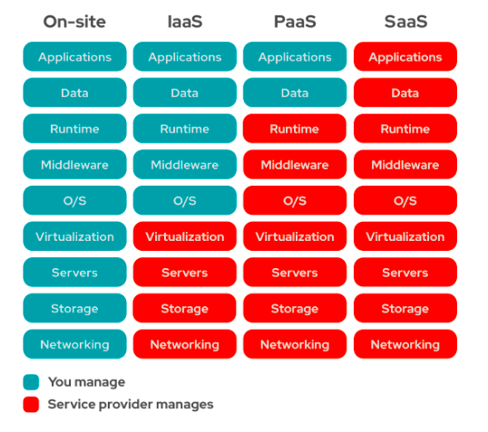

Slide 7
Who provides cloud computing?
Amazon Web Services (AWS)
Microsoft Azure
Google Cloud Platform
IBM Cloud
Oracle Cloud
Digital Ocean
Alibaba Cloud
Rackspace Cloud

Slide 8
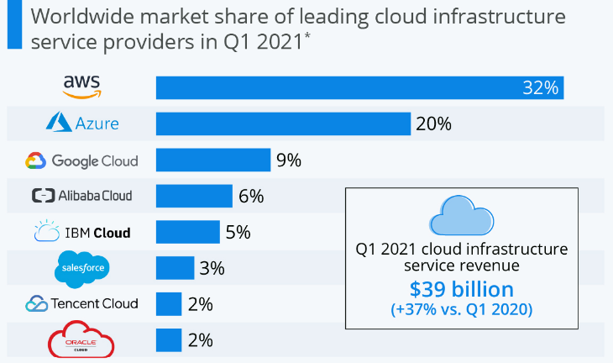
Market share of Leading cloud service provider

Slide 9
Why should we choose AWS?
Global Infrastructure (26 regions )
Availability Zones
Services and Features (200+ Services)
Flexibility
Security
The Free Tier
Pay as you go pricing model
High availability
Easy to use

